Slide 1

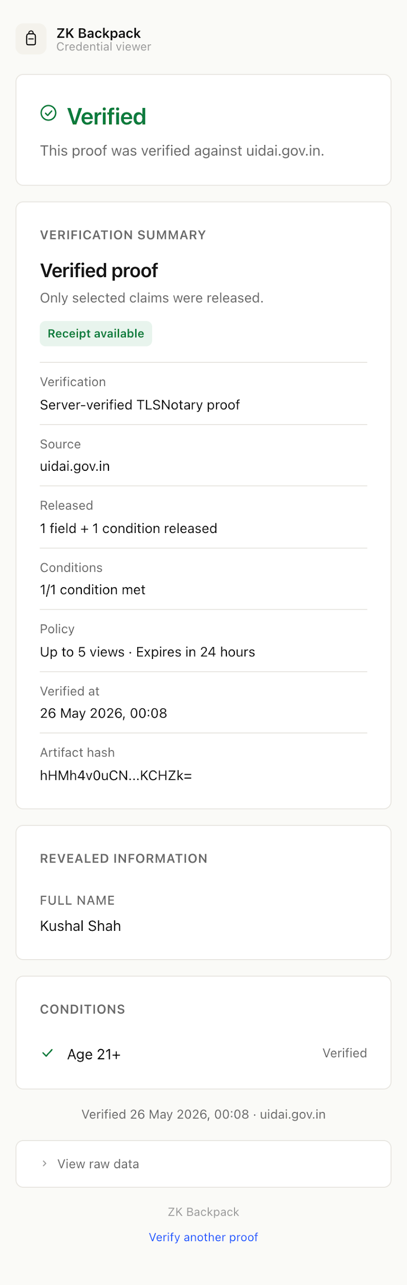
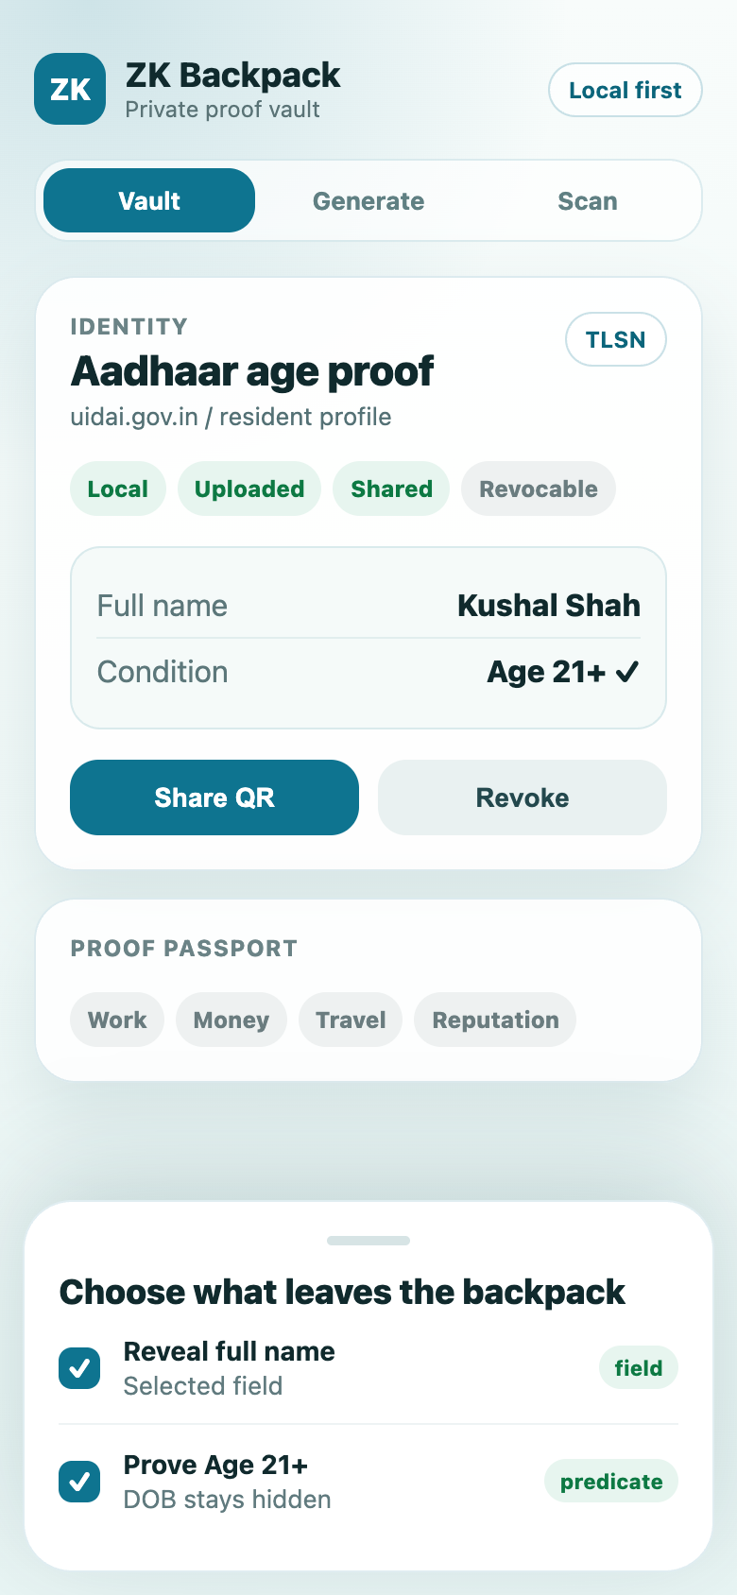
ZK Backpack
Private proof sharing that feels as simple as a document wallet.
A mobile vault for your web credentials:
generate once
reveal only the needed fact
let any recipient verify it in a browser.
Local encrypted vault
Scoped QR links
Revocable shares
Owner app
Recipient portal
01

Slide 2
REAL WORLD USE
One proof can serve many checks without oversharing.
Each verifier gets a narrow answer and cryptographic evidence. The user keeps the reusable proof in their backpack.
Age gates
Hiring
Fintech
Prove 21+ without DOB
Prove employer exists
Income threshold, not salary
Reusable proof
Backs different recipes: field reveal, predicate, expiry, one-time view, revoke.
User-controlled disclosure
Marketplaces
Travel
Account ownership + reputation
Ride activity without trip history
Verifier receives
status + scoped claims + predicate outcomes + receipt
Verifier does not receive
login, raw proof, full transcript, unrelated fields
02

Slide 3
LIVE DEMO
03

Slide 4
HOW IT WORKS
The raw proof stays behind a narrow verification pipeline.
The user creates a web proof, stores it encrypted locally, then mints a scoped token. The recipient portal only renders claims after server-side verification succeeds.
encrypted proof upload
TEE Compatible
verify full artifact
Flutter app
Local vault
share_service
Proof verifier
web_portal
Generate proof + choose fields or predicates
SQLite + AES-GCM; key in Keychain / Keystore
Encrypted blob store, tokens, revoke, receipts
POST /v1/artifacts/verify checks notary proof
No-install browser view: status + scoped claims
scoped claims only
Owner controls
Service enforces
Recipient sees
selection grammar, expiry, max views, one-time links, revoke
decrypt after token gates, verify, project claims, sign receipt
valid / expired / revoked status, released fields, conditions, receipt
Architecture: README.md and docs/architecture.md
04

Slide 5
SECURE BY DESIGN
Security is layered, and the risky boundaries are explicit.
This is a reference implementation with real cryptographic controls
Control
Why it matters
Local custody
Proofs live on device first; upload is per-share opt-in.
AES-GCM at rest
Mobile vault and backend blobs use authenticated encryption.
Share gates
Opaque tokens support expiry, max views, one-time use
Server verification
Proof verifier checks the artifact before claims render.
Signed receipt
HMAC receipt + audit JSONL make verification replayable
05

Slide 6
FINAL TAKEAWAY
Security review + what this app unlocks next
ZK Backpack is secure enough to demo today, and flexible enough to become a credential and agent platform.
CONTROLS ALREADY IN PLACE
NEXT PLATFORM MOVES
Security review
What we can do with this app
Local custody
OpenID4VP/DCQL
Proofs start encrypted on-device; uploads happen only per share.
Verifiers request facts by QR/link; Backpack answers from the vault.
Selective release
Offline receipts
Reveal exact fields or predicates instead of the full account payload.
Ed25519/JWKS receipts can verify later without calling the server.
Share gates
Proof bundles
One-time links, max views, expiry, and revoke keep users in control.
One share can combine age, work, income, and reputation checks.
Verified receipts
MCP server
TLSNotary checks run before claims render; receipts make proof replayable.
Agents and developer tools request scoped proofs through a simple API.
06

